Slide 1

Manufacturing
Downtime

Slide 2
Project Team
01
04
Mariam Mohamed Ali
Esraa Mohamed Abdullah
02
05
Amira Ibrahim Farghaly
Dalal Hossam Eldin
03
Salma Abdelkhalek Hussein

Slide 3
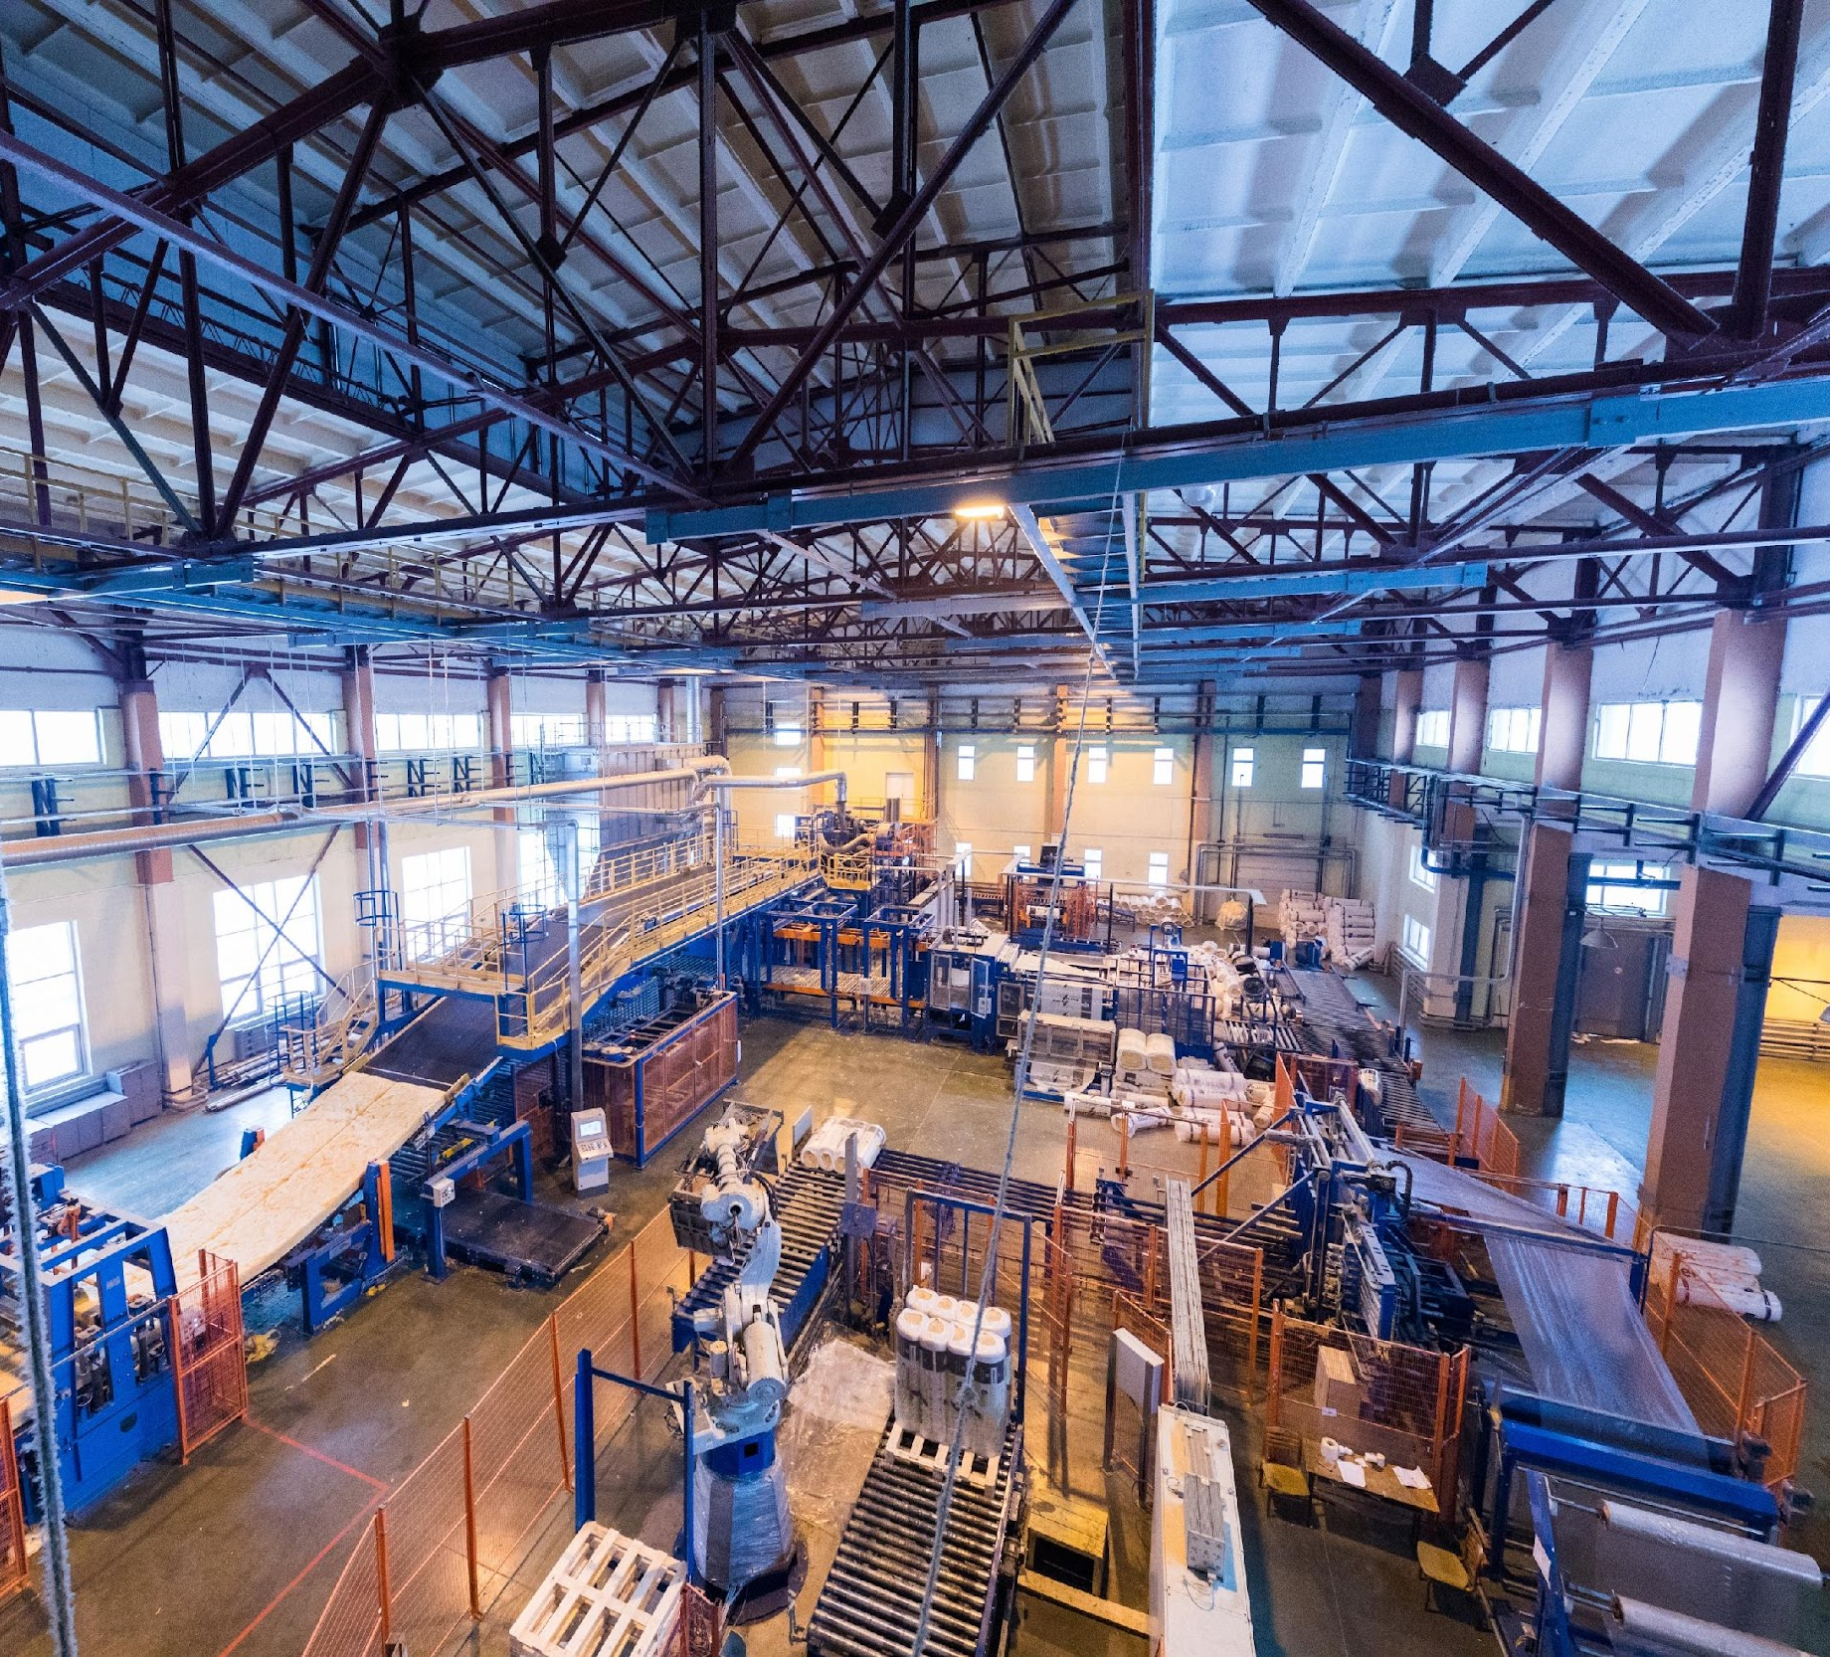
Project Overview
Manufacturing downtime is one of the key challenges affecting production efficiency. This project analyzes downtime events to identify the main causes of production interruptions and evaluate their impact on operational performance.
Using Microsoft Power BI, an interactive dashboard was developed to explore downtime patterns across machines, operators, and time periods, helping uncover the most critical factors behind production disruptions.

Slide 4

Data Source
The dataset was provided by the Digital Egypt Pioneers Initiative (DEPI) as part of a data analysis training project. It includes information about manufacturing downtime events such as machines, operators, downtime duration, and causes of interruptions.

Slide 5
Questions
What is the total downtime and its main drivers (machines, shifts, causes)?
Who are the best and worst operators?
Which products and batches cause the most losses?
What is the gap between actual and ideal performance?

Slide 6
Project Steps
01
Cleaning
04
Sample Visuals
Modeling
Dashboard
02
05
03
Dax
06
Reports

Slide 7
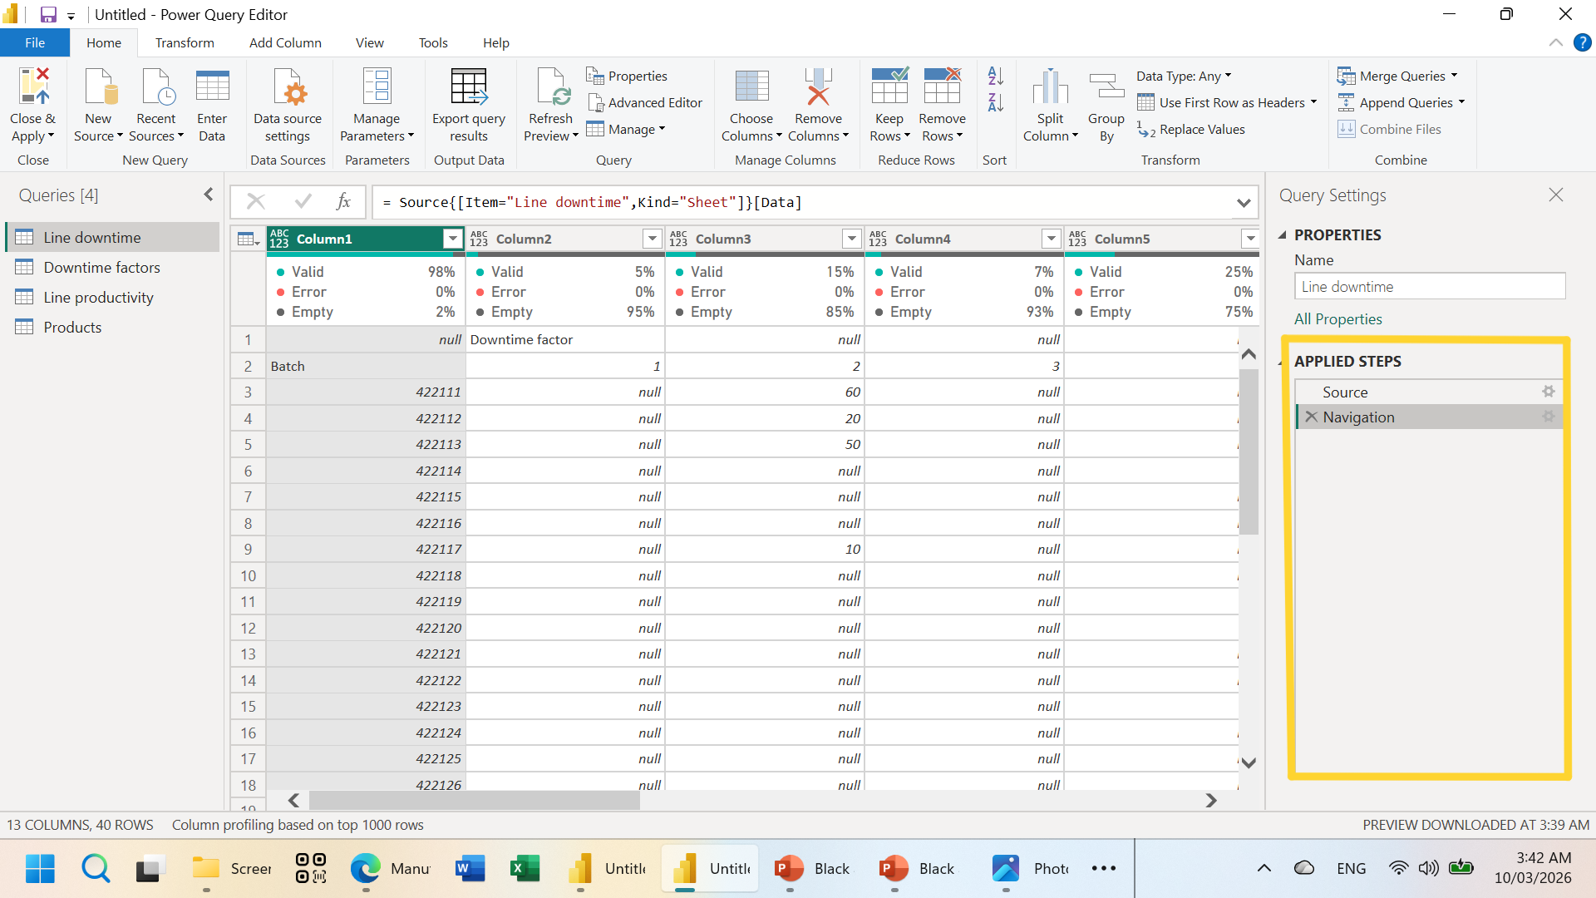
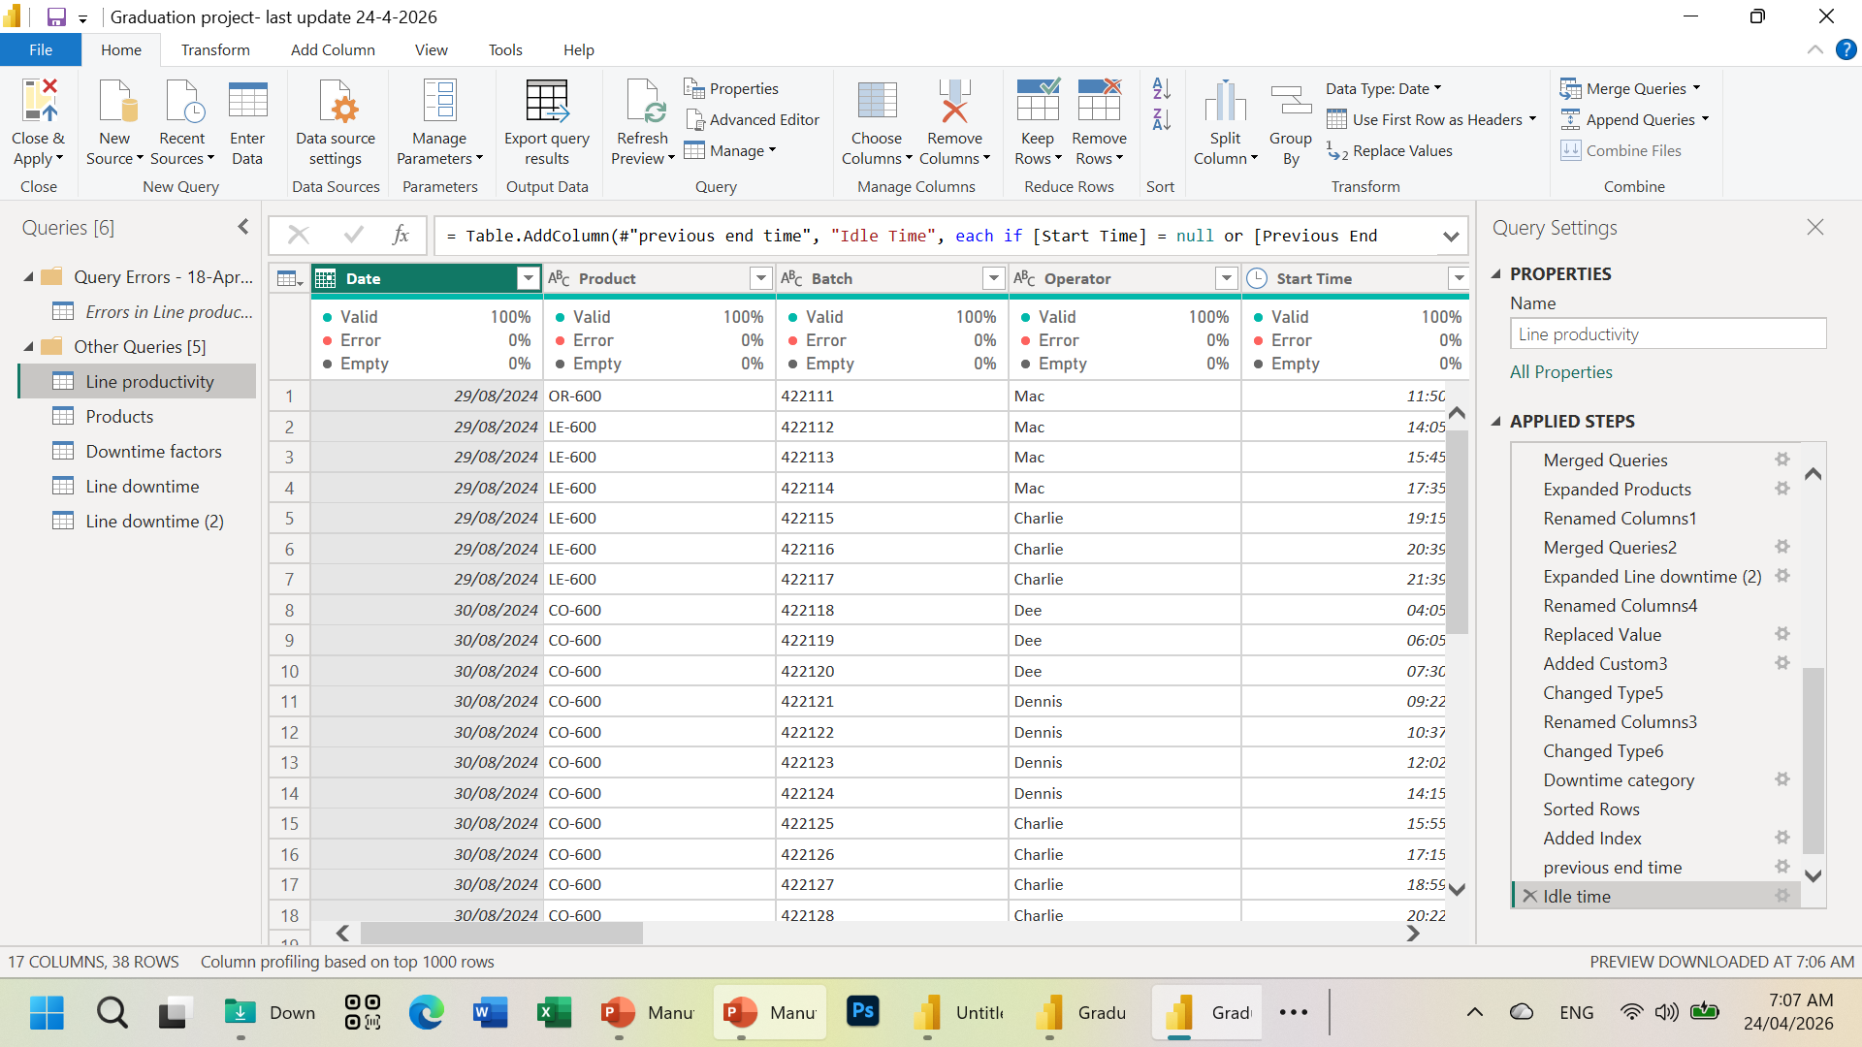
Cleaning
After
Before

Slide 8
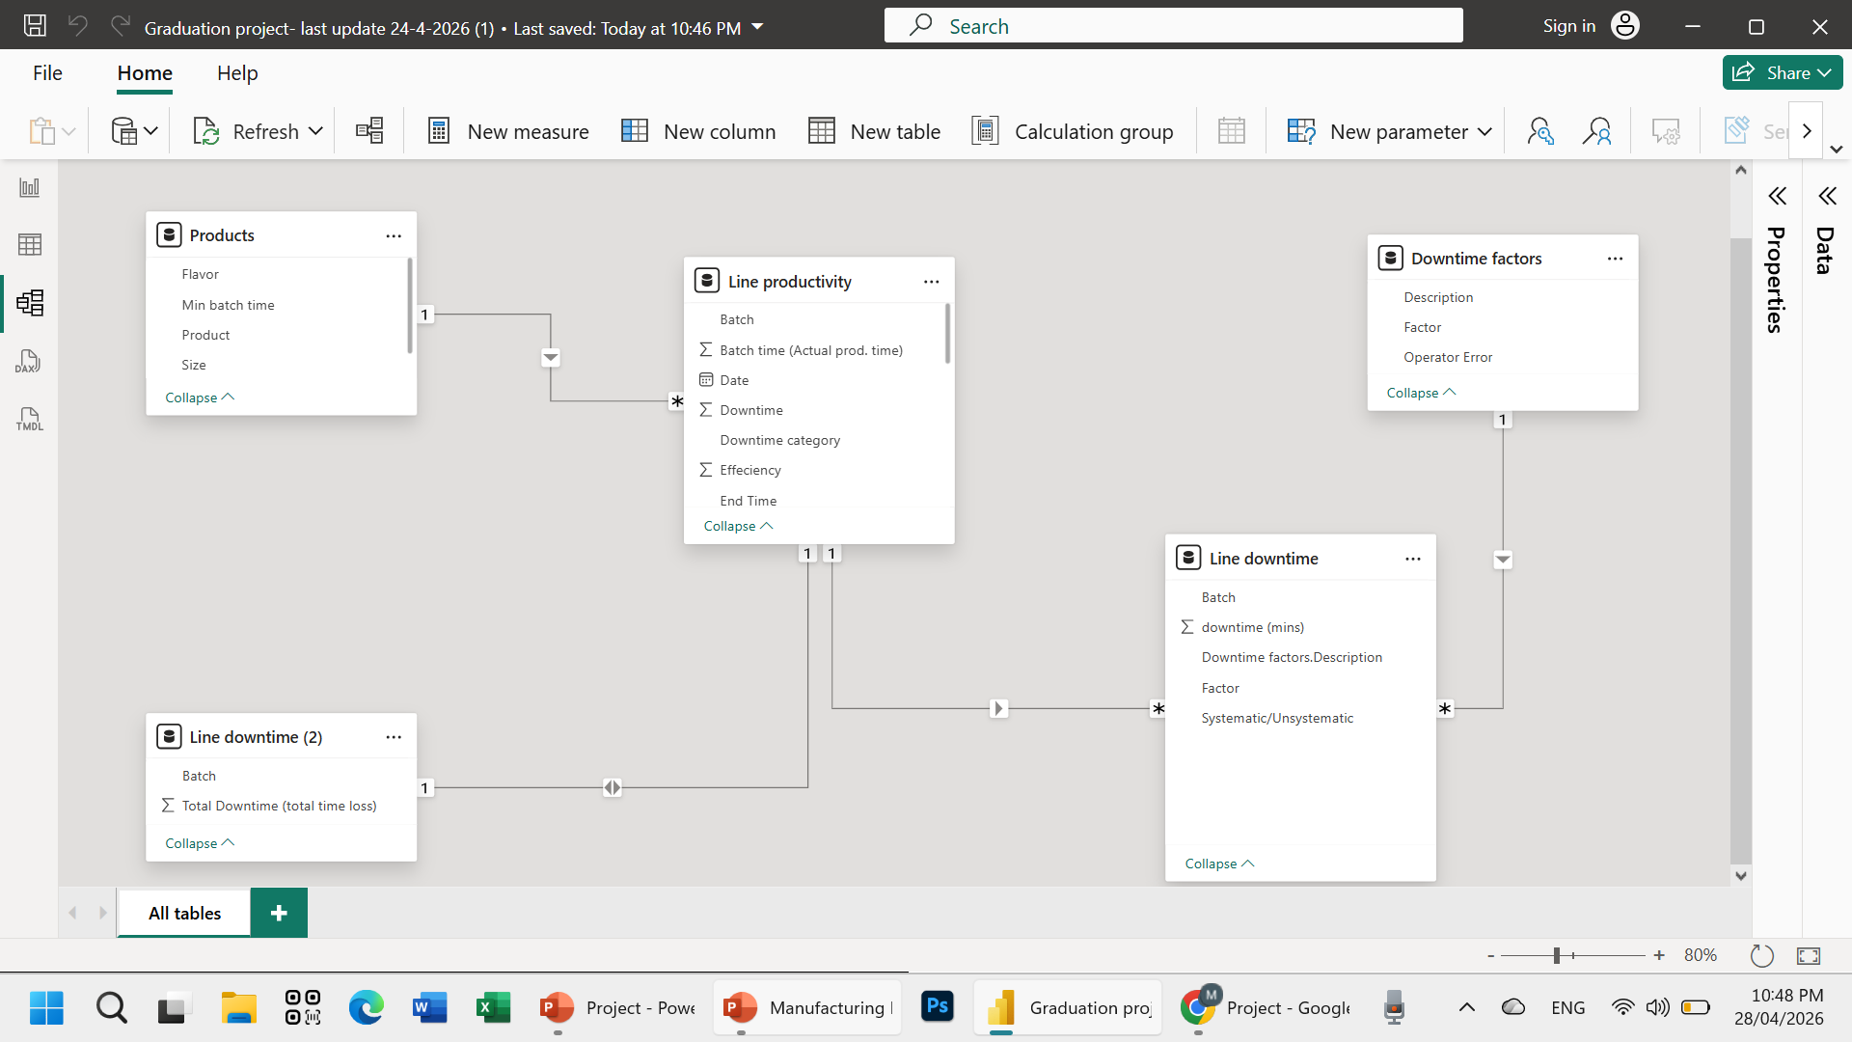
Modeling

Slide 9
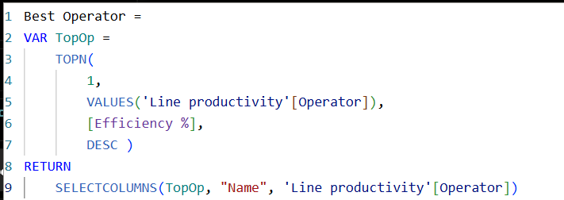
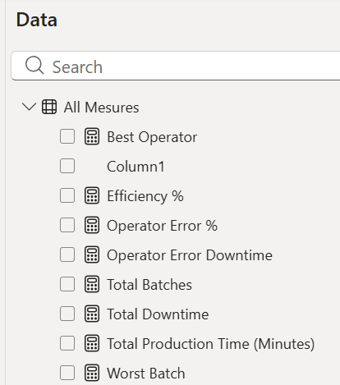
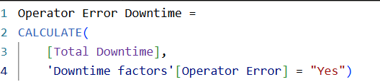
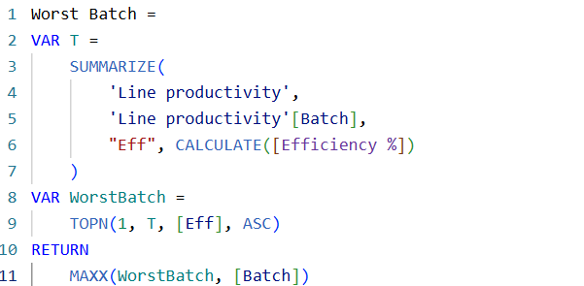
Dax

Slide 10
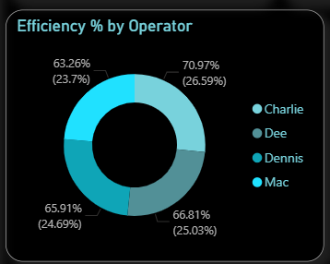
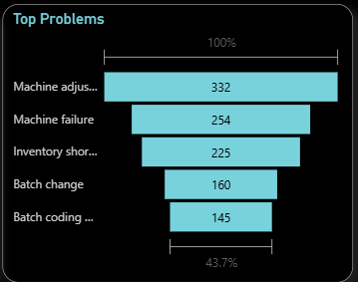
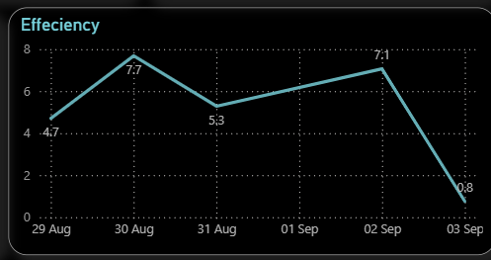
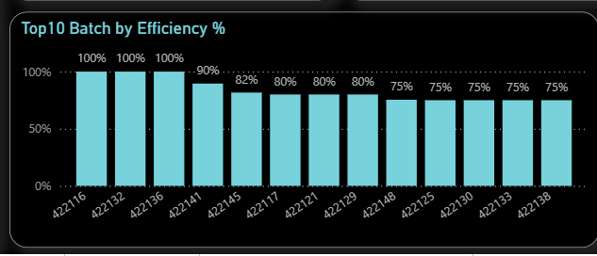

Sample Visuals
Pie Chart: shows parts of a whole (percentage distribution)
Funnel Chart: shows values in descending order to highlight the most important items.
Line Chart: shows trends and changes over time.
Column Chart: compares values across categories clearly.
Card: displays a single key KPI value clearly and simply.

Slide 11
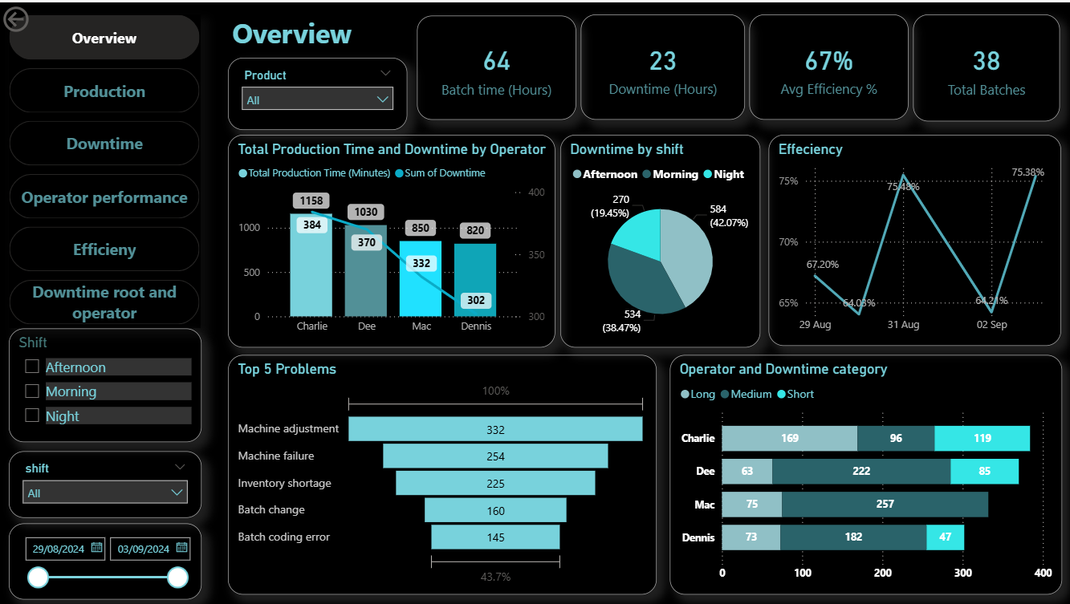

Slide 12
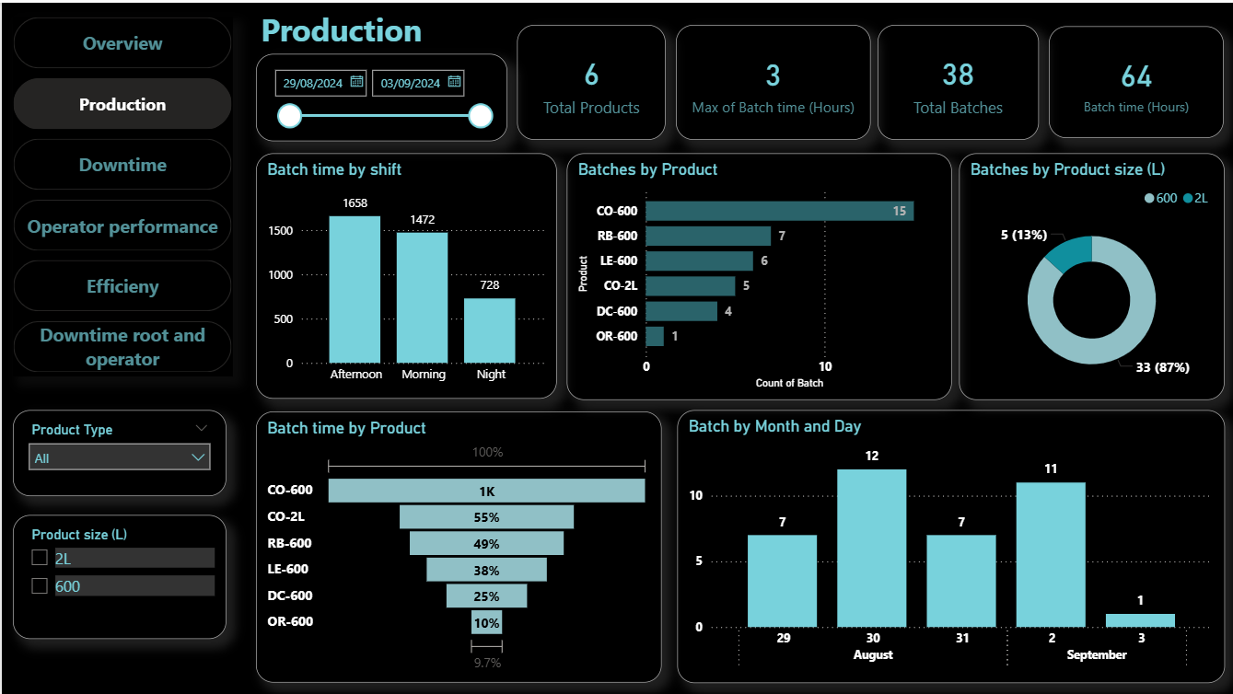

Slide 13
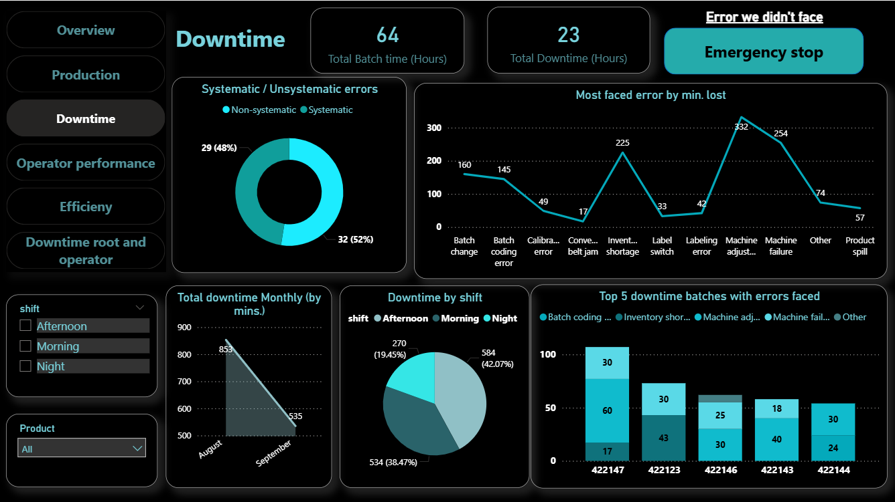

Slide 14
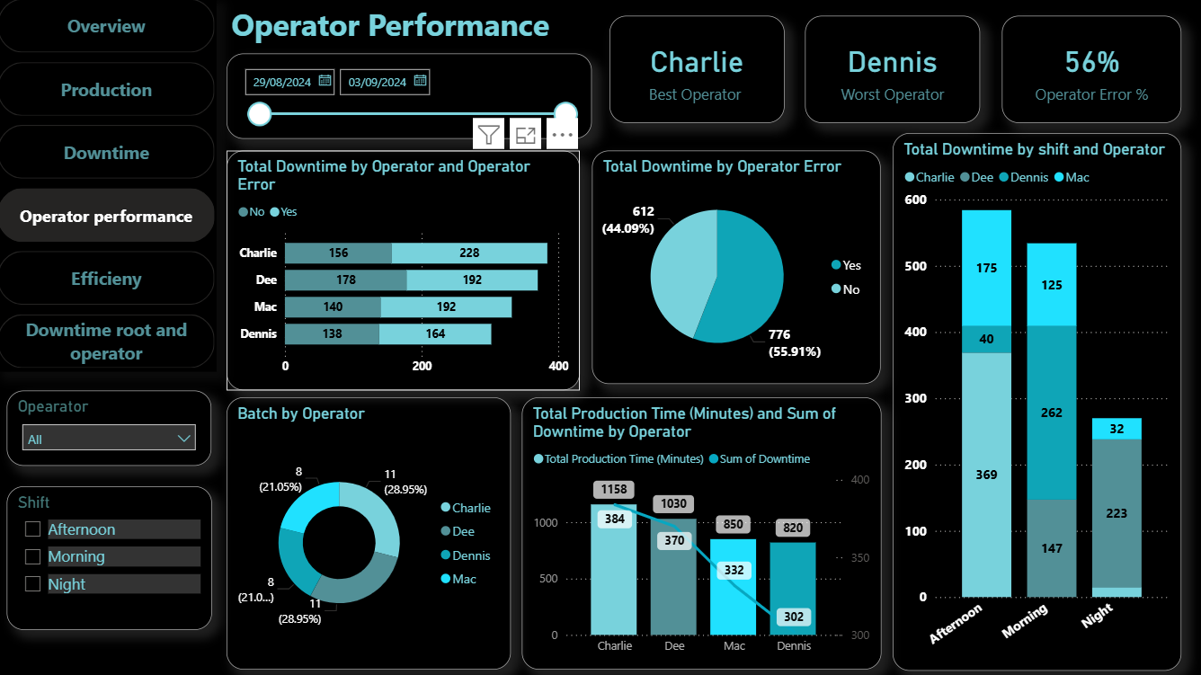

Slide 15
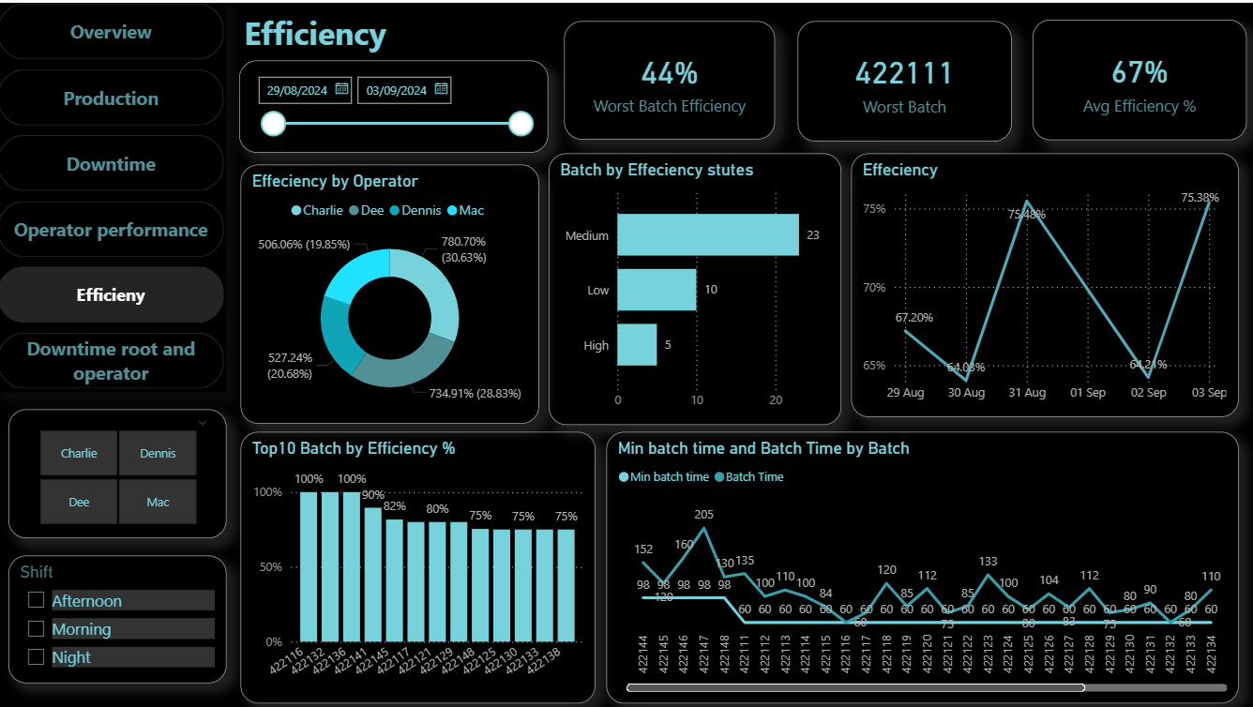

Slide 16
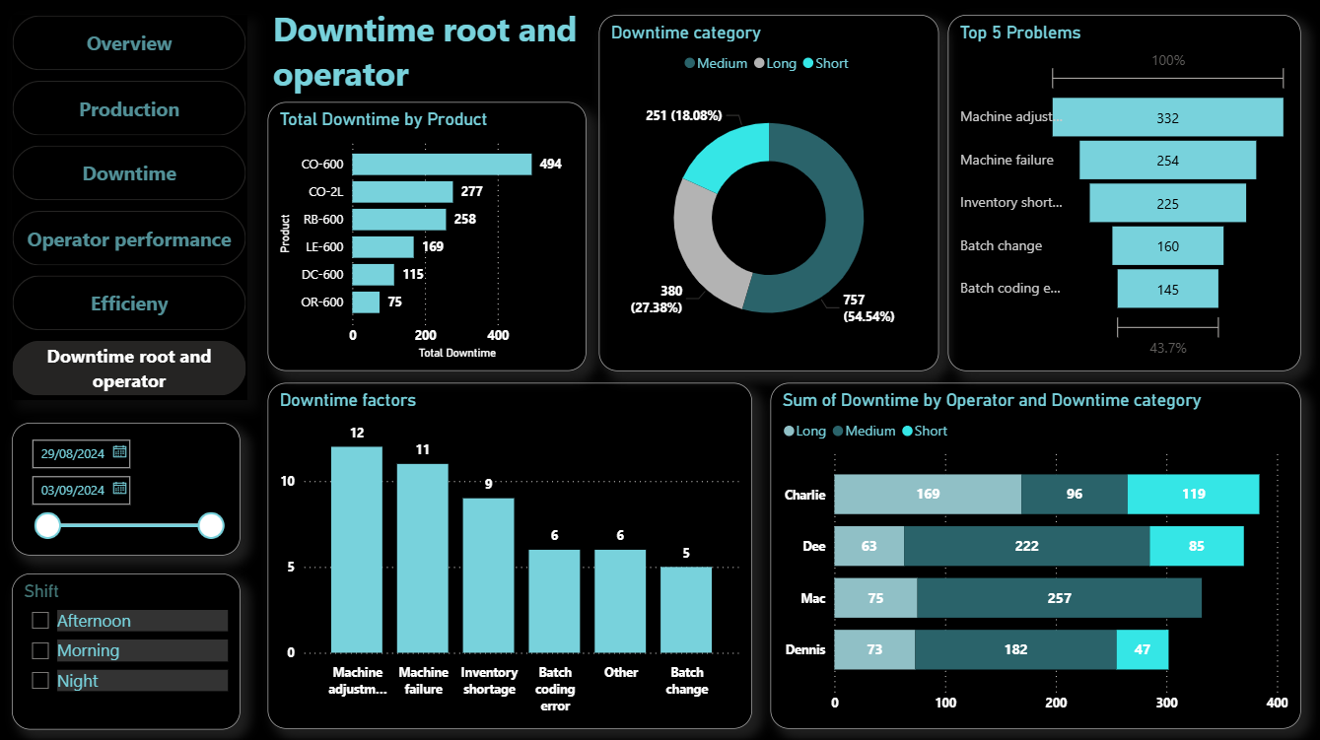

Slide 17
Insights
- Downtime is driven by a few critical causes (majority of losses)
- Operator performance varies, with noticeable skill gaps
- Product-related issues impact efficiency (e.g., OR-600)
- Significant gap between actual and ideal performance
- Performance inconsistency across shifts and days

Slide 18
Recommendations
- Train low-performing operators to reduce human errors
- Focus on fixing the most frequent downtime causes
- Conduct technical review for OR-600 production line
- Monitor and improve low-performing batches
- Optimize shift performance (especially evening shift)

Slide 19
Thank
You

